Slide 1
CS-744 Course Project Presentation
HTTP Based Key Value Server
Neeraj Patel
25m2133@iitb.ac.in

Slide 2
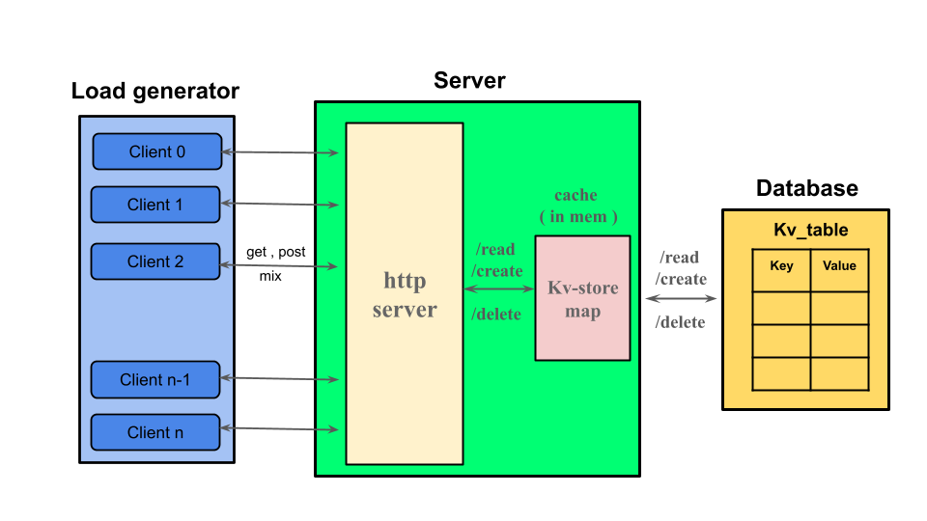
System Architecture
HTTP Server
  Entry point for client requests.
  Sends requests to cache or DB handler.
In-Memory LRU Cache of 1000 entry
  Implemented using un_ordered map
MySQL Database
Load Generator
  Spawn N clients
  Choose Put all / Popular

Slide 3
Development Process
The code written is distributed across files as such:
  server.cpp
  Load_generator.cpp
Third party tools used: cpp-httplib, pandas, matplotlib, overleaf .
Github link: https://github.com/Striender/DECS_PROJECT.git

Slide 4
Load Generator Design
Architecture: Multi-threaded C++ client using httplib; each thread sends continuous requests (GET / PUT / DELETE / POPULAR).
Design Type: Closed-loop — every thread waits for the server's reply before sending the next request.
Workload Modes:
PUT-ALL (create/delete)
POPULAR (10 hot keys → high cache hit-rate)
How load was maximized:
Zero think-time between request
Increased thread count until server saturation
Verified client CPU not the bottleneck (via pidstat -p <pid> <second>)

Slide 5
Load Test Setup
Configuration: Load generator process in pinned to CPU core 2,3,4 using taskset to ensure consistent load generation.
Load Level: Increasing no of threads linearly 1,2,3 and so on till i identify saturation points.
Duration: Each experiment run lasted for 5 minutes.
Metrics: Measured Throughput (req/s), Response latency (ms), CPU utilization and disk I/O utilization.

Slide 6
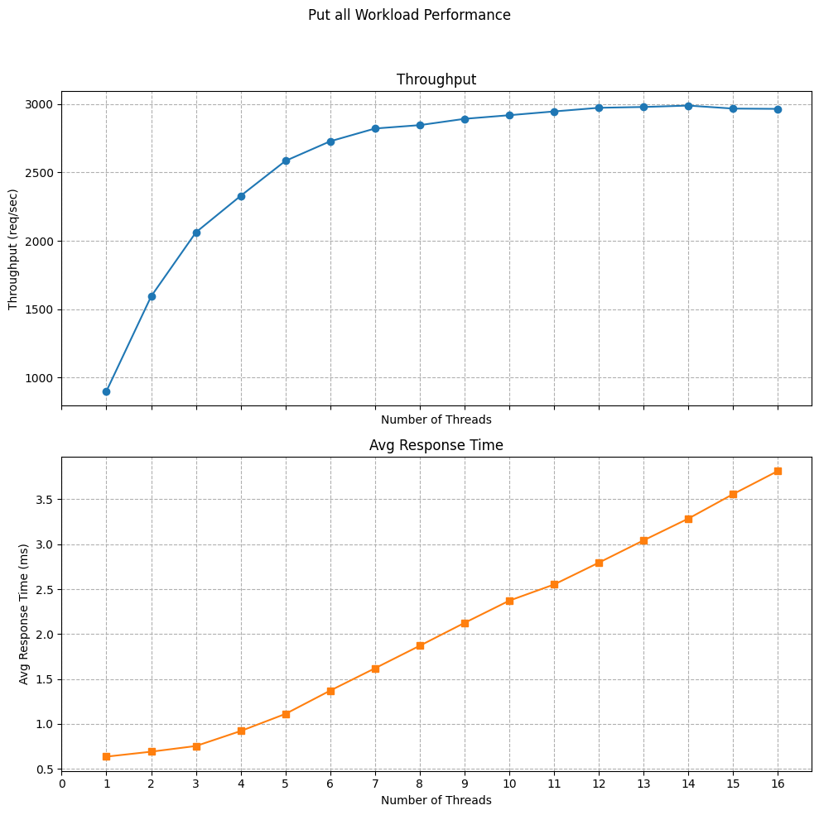
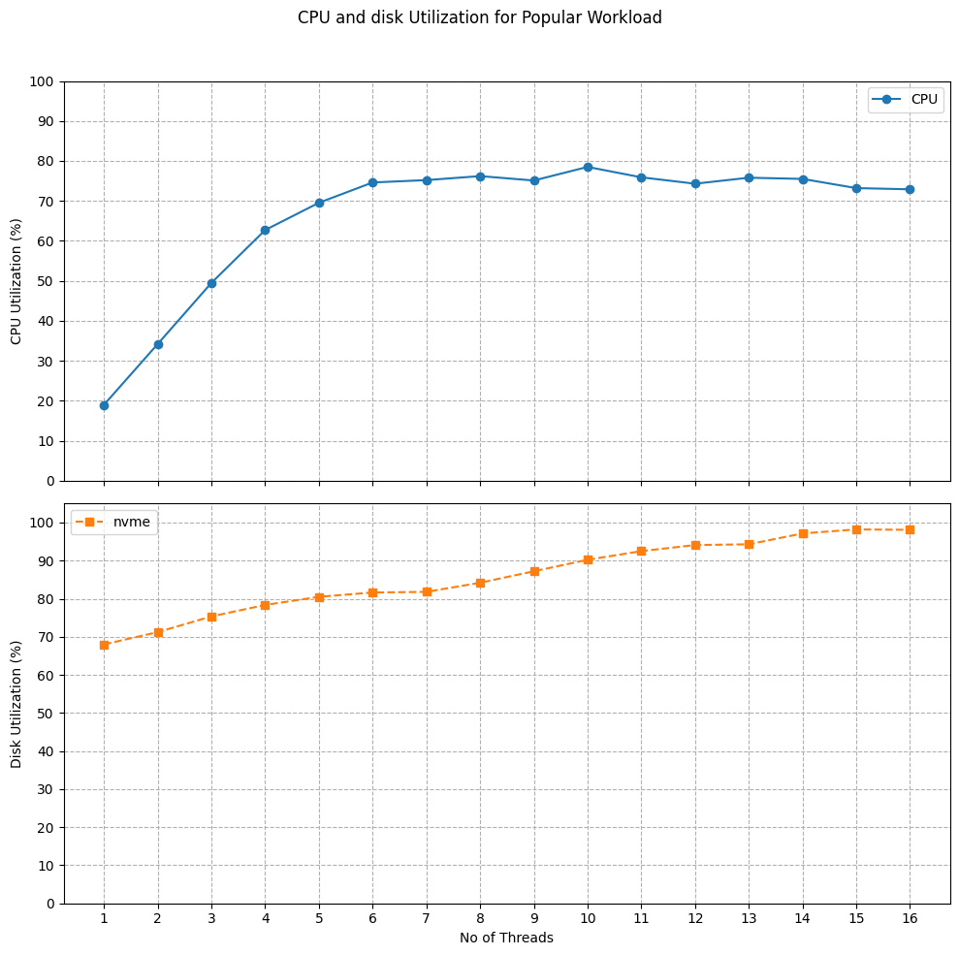
Workload - PUT ALL

Slide 7
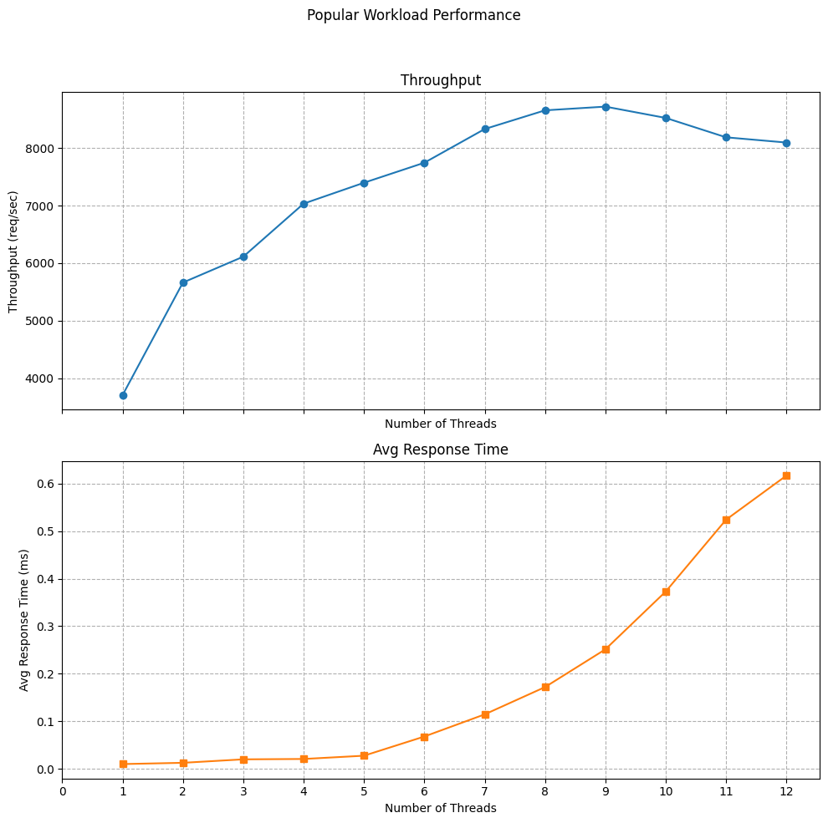
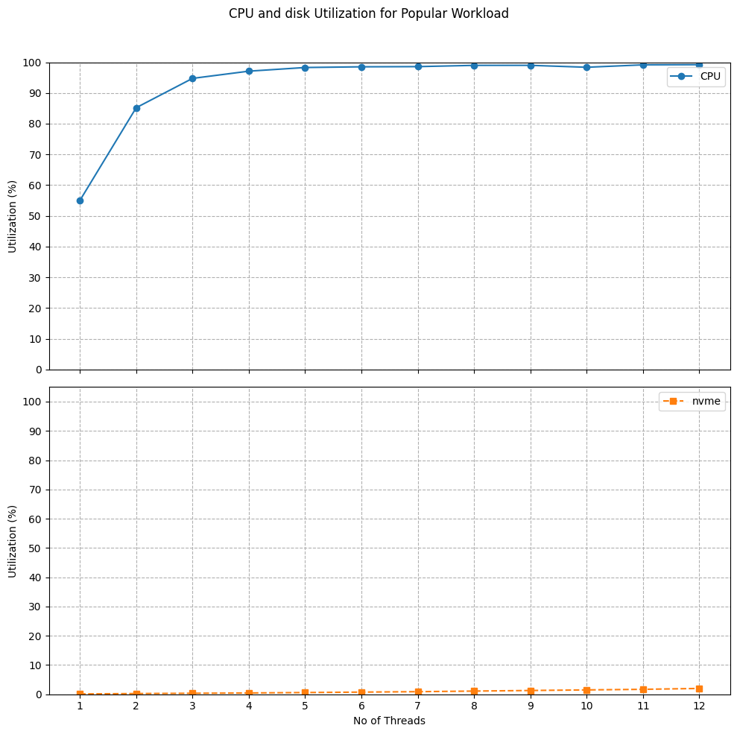
Workload - Popular

